Slide 1
Spline Interpolation: Cubic Spline Interpolation (CSI)
Lecture-2

Slide 2
Objectives
Introduce MATLAB Spline Interpolation Functions
Solve problems by using Cubic Spline Interpolation
Draw curve by applying MATLAB Spline Interpolation
Functions

Slide 3
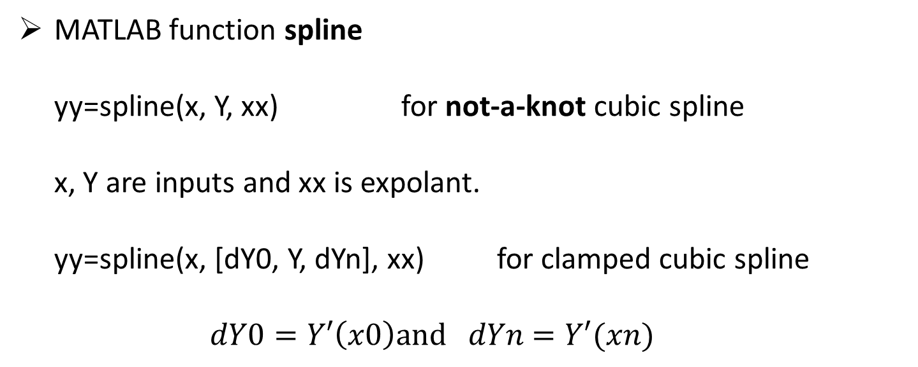
MATLAB Spline Interpolation Functions
MATLAB function spline
yy=spline(x, Y, xx) for not-a-knot cubic spline
x, Y are inputs and xx is expolant.
yy=spline(x, [dY0, Y, dYn], xx) for clamped cubic spline
$dY0=Y′\left(x0\right)and dYn=Y′(xn)$

Slide 4
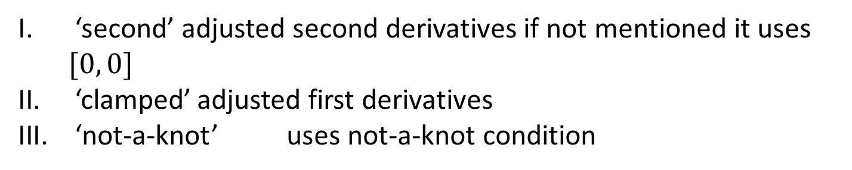
csape spline interpolation with various end conditions
Syntax: sp=csape(X, Y, conds)
some of the conditions are
‘second’ adjusted second derivatives if not mentioned it uses $[0, 0]$
‘clamped’ adjusted first derivatives
‘not-a-knot’ uses not-a-knot condition

Slide 5
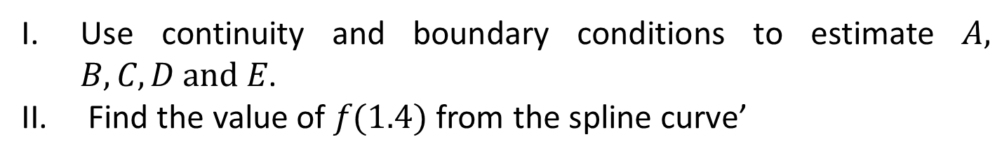
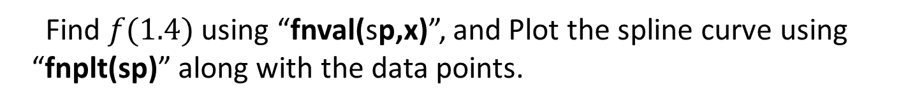
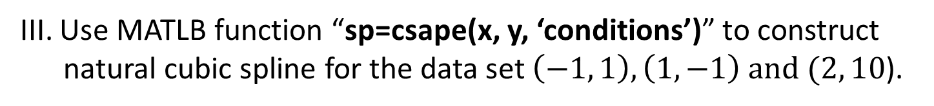
Solve Problems
Example #1: A natural cubic spline is defined by
$$f\left(x\right)=\left\{\begin{aligned}A{\left(x+1\right)}^{3}+B{\left(x+1\right)}^{2}+C\left(x+1\right)+1, &−1≤x<1 \\ D{\left(x−1\right)}^{3}+6{\left(x−1\right)}^{2}+E\left(x−1\right)−1, &1≤x≤2\end{aligned}\right.$$
Use continuity and boundary conditions to estimate $A, B, C, D and E$.
Find the value of $f(1.4)$ from the spline curve’
III. Use MATLB function “sp=csape(x, y, ‘conditions’)” to construct
natural cubic spline for the data set $\left(−1, 1\right), \left(1, −1\right) and (2, 10$).
Find $f(1.4)$ using “fnval(sp,x)”, and Plot the spline curve using
“fnplt(sp)” along with the data points.

Slide 6
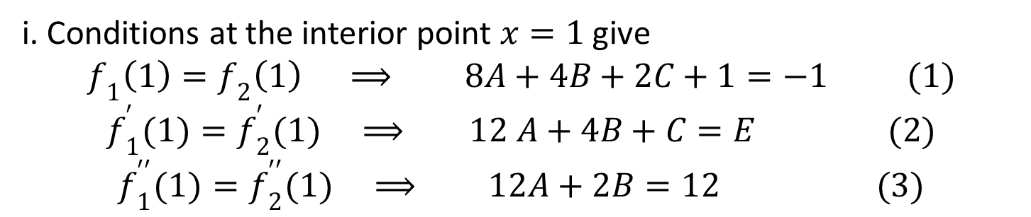
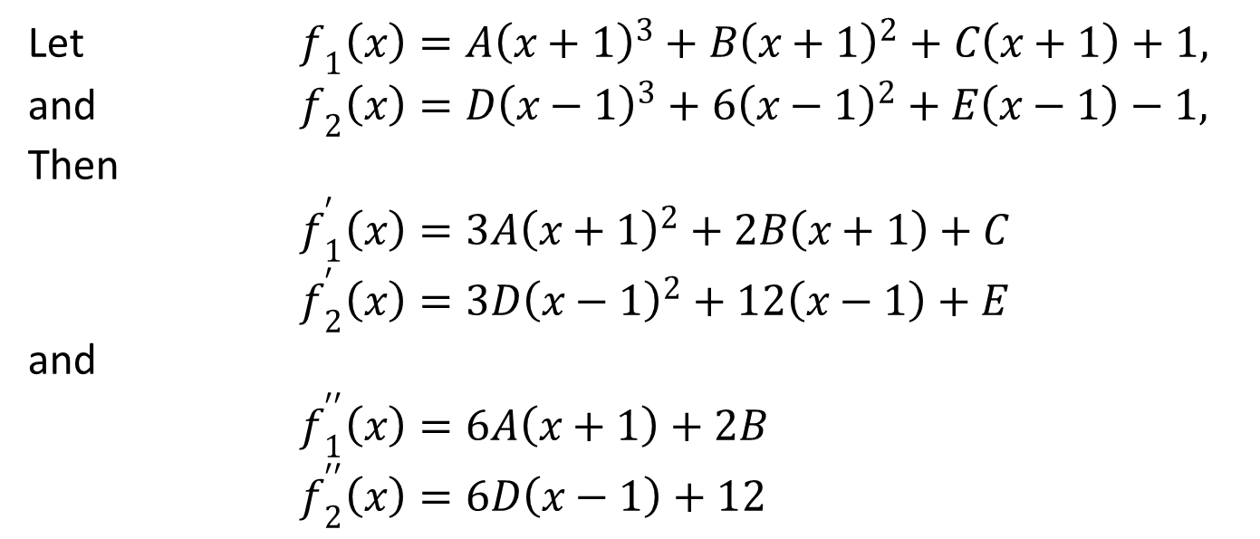
Solutions:
Let $f_{1}\left(x\right)=A{\left(x+1\right)}^{3}+B{\left(x+1\right)}^{2}+C\left(x+1\right)+1,$
and $f_{2}\left(x\right)=D{\left(x−1\right)}^{3}+6{\left(x−1\right)}^{2}+E\left(x−1\right)−1,$
Then
$f_{1}^{′}\left(x\right)=3A{\left(x+1\right)}^{2}+2B\left(x+1\right)+C$
$f_{2}^{′}\left(x\right)=3D{\left(x−1\right)}^{2}+12\left(x−1\right)+E$
and
$f_{1}^{′′}\left(x\right)=6A\left(x+1\right)+2B$
$f_{2}^{′′}\left(x\right)=6D\left(x−1\right)+12$
i. Conditions at the interior point $x=1$ give
$$f_{1}\left(1\right)=f_{2}\left(1\right) ⟹ 8A+4B+2C+1=−1 (1)$$
$$f_{1}^{′}(1)=f_{2}^{′}(1) ⟹ 12 A+4B+C=E (2)$$
$$f_{1}^{′′}(1)=f_{2}^{′′}(1) ⟹ 12A+2B=12 (3)$$

Slide 7
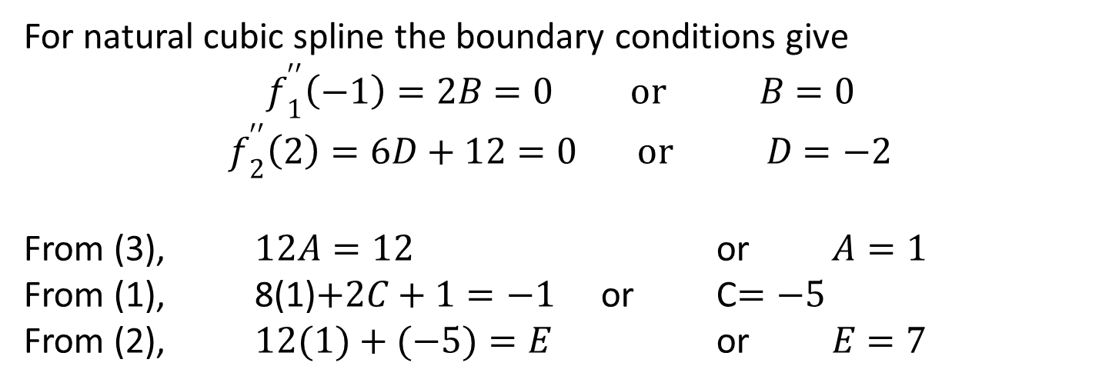
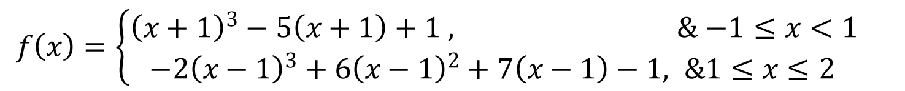
For natural cubic spline the boundary conditions give
$$f_{1}^{′′}\left(−1\right)=2B=0 or B=0$$
$$f_{2}^{′′}\left(2\right)=6D+12=0 or D=−2$$
From (3), $12A=12$ or $A=1$
From (1), 8(1)$+2C+1=−1$ or C$=−5$
From (2), $12(1)+(−5)=E$ or $E=7$
The natural cubic spline function is
$f\left(x\right)=\left\{\begin{aligned}{\left(x+1\right)}^{3}−5\left(x+1\right)+1 , &−1≤x<1 \\ −2{\left(x−1\right)}^{3}+6{\left(x−1\right)}^{2}+7\left(x−1\right)−1, &1≤x≤2\end{aligned}\right.$

Slide 8
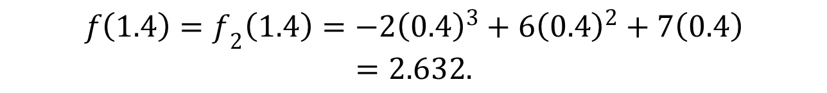
$f\left(x\right)=−2{\left(x−1\right)}^{3}+6{\left(x−1\right)}^{2}+7\left(x−1\right)−1, \&1≤x≤2$
$$f\left(1.4\right)=f_{2}\left(1.4\right)=−2{\left(0.4\right)}^{3}+6{\left(0.4\right)}^{2}+7\left(0.4\right)$$
$$=2.632.$$
iii.
>> clear
>> x=[-1 1 2];
>> y=[1 -1 10];
>> sp=csape(x,y,'second');
>> y1=fnval(sp,1.4)
y1 =
2.6320

Slide 9
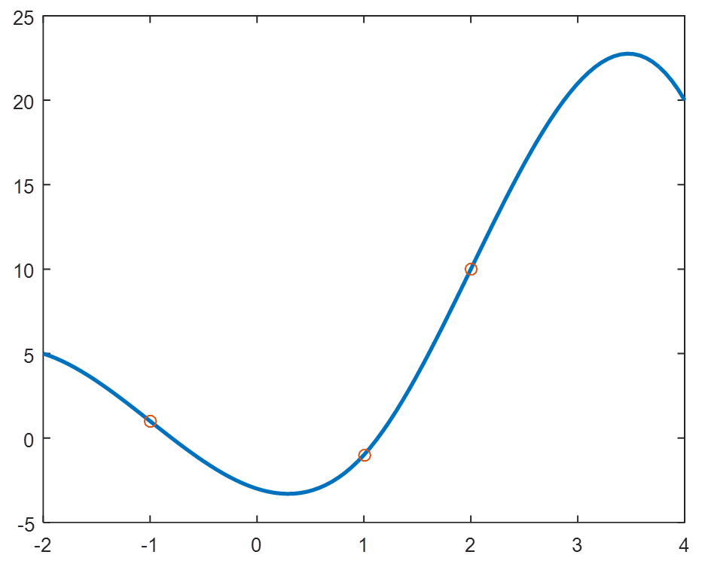
>> fnplt(sp, 2, [-2, 4])
>> hold on % used to plot in the same figure
>> plot(x, y,'O')
>> hold off
Cubic spline curve

Slide 10
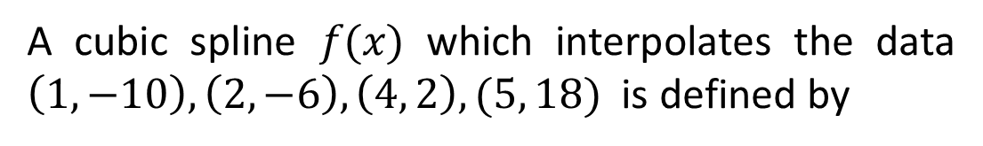
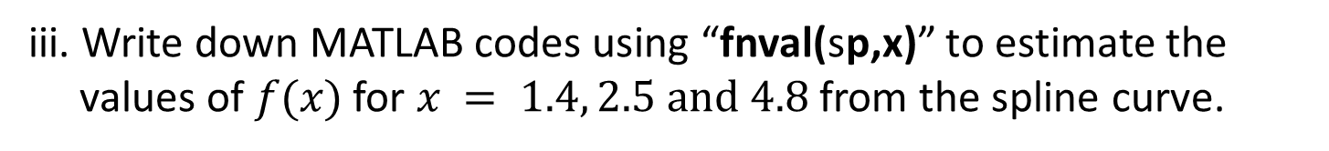
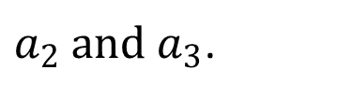
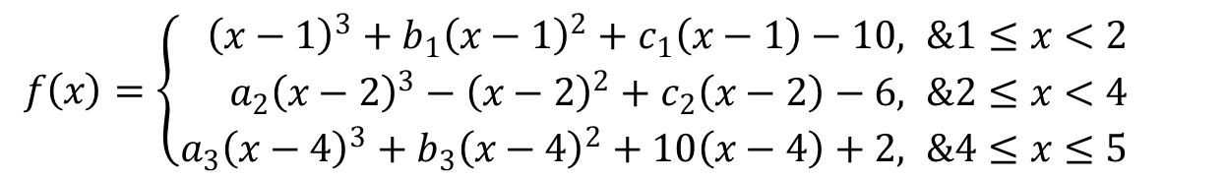
Example #2:
A cubic spline $f(x)$ which interpolates the data $\left(1, −10\right), \left(2, −6\right), \left(4, 2\right), (5, 18)$ is defined by
$f\left(x\right)=\left\{\begin{aligned}{\left(x−1\right)}^{3}+b_{1}{\left(x−1\right)}^{2}+c_{1}\left(x−1\right)−10, &1≤x<2 \\ a_{2}{\left(x−2\right)}^{3}−{\left(x−2\right)}^{2}+c_{2}\left(x−2\right)−6, &2≤x<4 \\ a_{3}{\left(x−4\right)}^{3}+b_{3}{\left(x−4\right)}^{2}+10\left(x−4\right)+2, &4≤x≤5\end{aligned}\right.$
i. If the spline satisfies the not-a-knot boundary conditions, find
$a_{2} and a_{3}$.
ii. Use MATLB function “sp=spline(x, y)” to construct the spline
curve and find coefficients by “sp.coefs”.
iii. Write down MATLAB codes using “fnval(sp,x)” to estimate the
values of $f(x)$ for $x = 1.4, 2.5 and 4.8$ from the spline curve.
iv. Write down MATLAB codes using “fnplt(sp)” to plot the spline
curve and the given data points.

Slide 11
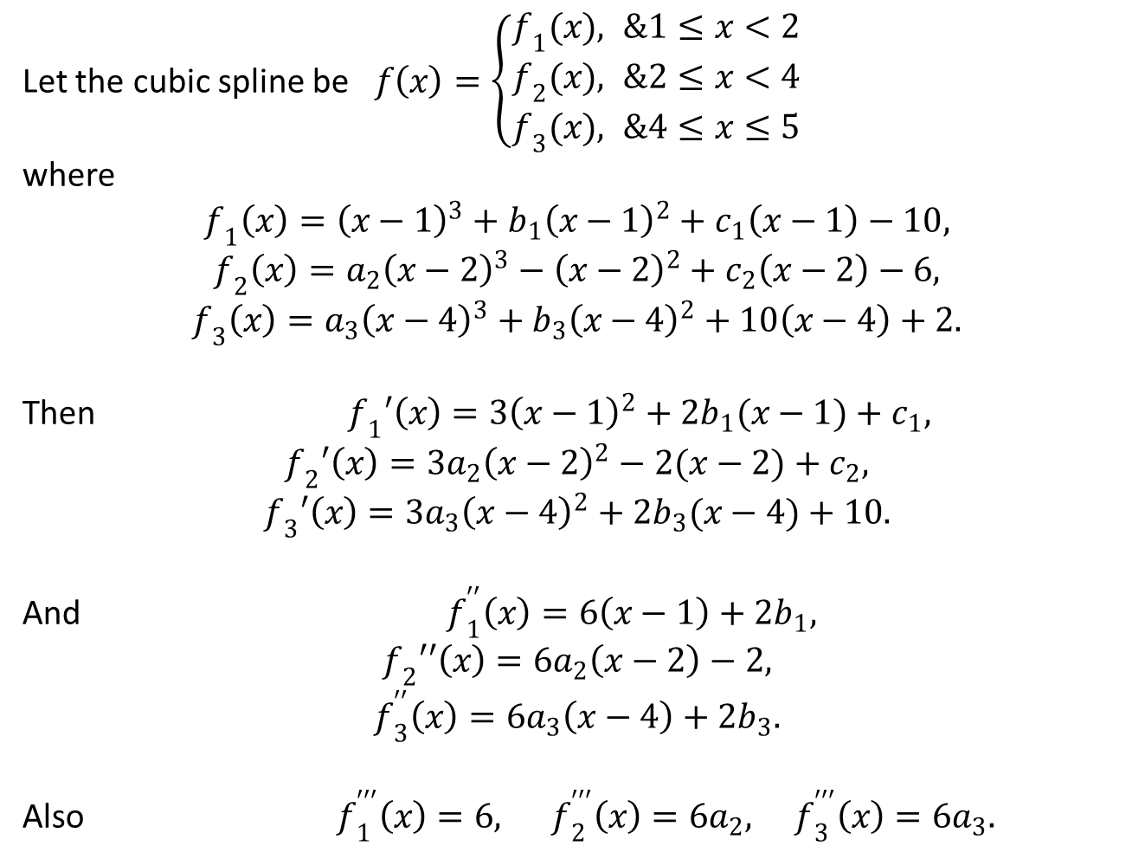
Solutions:
Let the cubic spline be $f\left(x\right)=\left\{\begin{aligned}f_{1}(x), &1≤x<2 \\ f_{2}(x), &2≤x<4 \\ f_{3}(x), &4≤x≤5\end{aligned}\right.$
where
$${f_{1}\left(x\right)=\left(x−1\right)}^{3}+b_{1}{\left(x−1\right)}^{2}+c_{1}\left(x−1\right)−10,$$
$$f_{2}\left(x\right)=a_{2}{\left(x−2\right)}^{3}−{\left(x−2\right)}^{2}+c_{2}\left(x−2\right)−6,$$
$$f_{3}\left(x\right)=a_{3}{\left(x−4\right)}^{3}+b_{3}{\left(x−4\right)}^{2}+10\left(x−4\right)+2.$$
Then ${f_{1}′\left(x\right)=3\left(x−1\right)}^{2}+2b_{1}(x−1)+c_{1},$
$$f_{2}′\left(x\right)={3a}_{2}{\left(x−2\right)}^{2}−2(x−2)+c_{2},$$
$$f_{3}′\left(x\right)={3a}_{3}{\left(x−4\right)}^{2}+{2b}_{3}(x−4)+10.$$
And $f_{1}^{′′}\left(x\right)=6\left(x−1\right)+2b_{1},$
$$f_{2}′′\left(x\right)=6a_{2}\left(x−2\right)−2,$$
$$f_{3}^{′′}\left(x\right)={6a}_{3}\left(x−4\right)+2b_{3}.$$
Also $f_{1}^{′′′}\left(x\right)=6, f_{2}^{′′′}\left(x\right)=6a_{2}, f_{3}^{′′′}\left(x\right)=6a_{3}.$

Slide 12
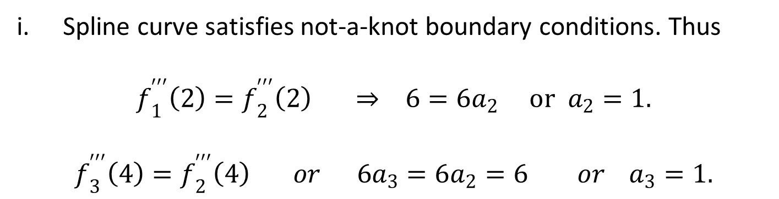
Spline curve satisfies not-a-knot boundary conditions. Thus
$$f_{1}^{′′′}\left(2\right)=f_{2}^{′′′}\left(2\right) ⇒ 6=6a_{2} or a_{2}=1.$$
$$f_{3}^{′′′}\left(4\right)=f_{2}^{′′′}\left(4\right) or 6a_{3}=6a_{2}=6 or { a}_{3}=1.$$
ii.
>> x=[1 2 4 5];
>> y=[-10 -6 2 18];
>> sp=spline(x,y);
>> format short g
>> Coefficients = sp.coefs
Coefficients =
1 -4 7 -10
1 -1 2 -6
1 5 10 2

Slide 13
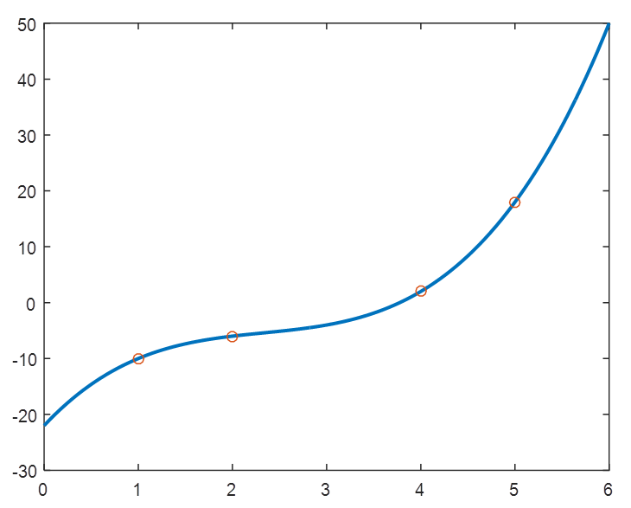
iii.
>> x1=[1.4, 2.5, 4.8];
>> y1=fnval(sp,x1);
>> xy_value =[x1', y1']
Cubic spline curve
xy_value =
1.4 -7.776
2.5 -5.125
4.8 13.712
iv.
>> fnplt(sp, [0, 6])
>> hold on
>> plot(x,y,'o')

Slide 14
Outcomes
Functions can be derived by using Cubic Spline Interpolation (CSI) from given data sets.
Functions can be plotted by using built in function in MATLAB for Cubic Spline Interpolation (CSI).

Slide 15
Multiple questions:
S.No. | Questions
1 | Which command can be used to find coefficients after constructing spline curve in MATHLAB by? sp.coefs, esape(x, y, ‘conditions’), None of them
2 | By using Cubic Spline Interpolation (CSI) from available data sets- Functions can be derived, Functions can not be derived, None of them, Both of them
3 | By applying built in function in MATLAB for Cubic Spline Interpolation - Functions can be plotted, Functions can not be plotted , Both of them
4 | Which command can be used for to construct natural cubic spline for the given data set? csape(x, y, ‘conditions’), esape(x, y, ‘conditions’), None of them

Slide 16
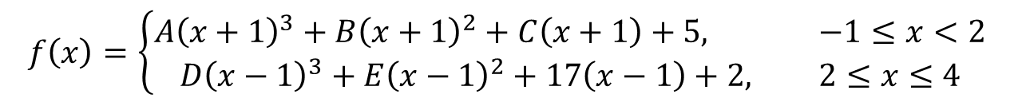
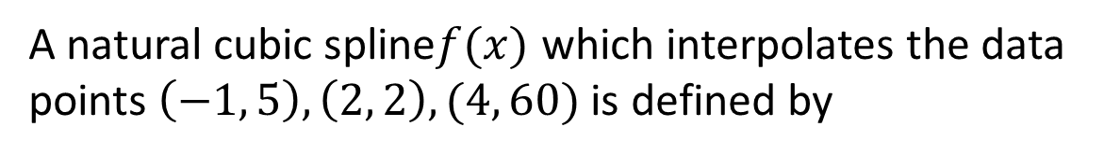
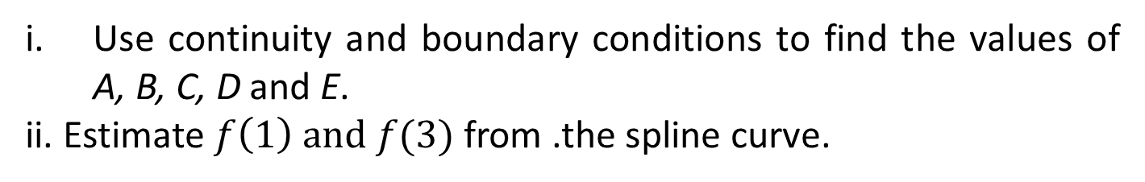
Try to do yourself
Exercise 1:
A natural cubic spline$f(x)$ which interpolates the data points $\left(−1, 5\right), \left(2, 2\right), (4, 60)$ is defined by
$$f\left(x\right)=\left\{\begin{aligned}A{\left(x+1\right)}^{3}+B{\left(x+1\right)}^{2}+C\left(x+1\right)+5, &−1≤x<2 \\ D{\left(x−1\right)}^{3}+E{\left(x−1\right)}^{2}+17\left(x−1\right)+2, &2≤x≤4\end{aligned}\right.$$
Use continuity and boundary conditions to find the values of A, B, C, D and E.
ii. Estimate $f\left(1\right) and f(3)$ from .the spline curve.

Slide 17
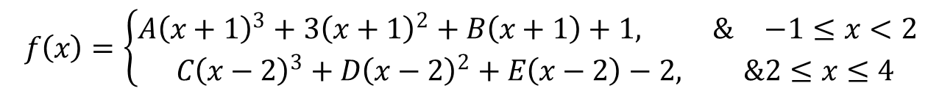
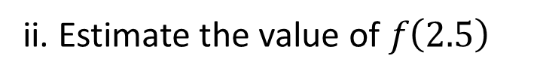
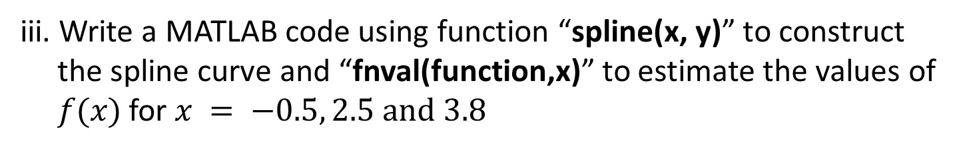
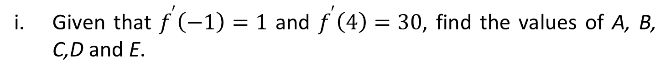
Exercise 2:
A clamped cubic spline function through (-1,1), (2,-2) (4,30) is defined by
$$f\left(x\right)=\left\{\begin{aligned}A{\left(x+1\right)}^{3}+3{\left(x+1\right)}^{2}+B\left(x+1\right)+1, &−1≤x<2 \\ C{\left(x−2\right)}^{3}+D{\left(x−2\right)}^{2}+E\left(x−2\right)−2, &2≤x≤4\end{aligned}\right.$$
Given that $f^{′}\left(−1\right)=1$ and $f^{′}\left(4\right)=30$, find the values of A, B, C,D and E.
ii. Estimate the value of $f\left(2.5\right)$
iii. Write a MATLAB code using function “spline(x, y)” to construct
the spline curve and “fnval(function,x)” to estimate the values of
$f(x)$ for $x = −0.5, 2.5 and 3.8$

Slide 18
References
[1] Applied Numerical Methods With Matlab for Engineers and Scientists ( Steven
C.Chapra).
[2] Applied Numerical Analysis – C.F.Gerald & P.O.Wheatley, 7th Edition, 2003,
Pearson Education Limited, USA.
[3] Numerical Analysis & Computing – W. Cheney & D. Kincaid, 6th Edition, 2007,
Cengage Learning, Inc, USA.
[4] Numerical Analysis – J. Douglas Faires , Annette Burden , Richard Burden, 10th
Edition, 2015, Cengage Learning, Inc, USA.

